Slide 1




Knights Technical Presentation
Robotics Dojo 2025
Amos Oniare
Dismas Karimi
Gareth Kipkoech
Brian Fundi

Slide 2
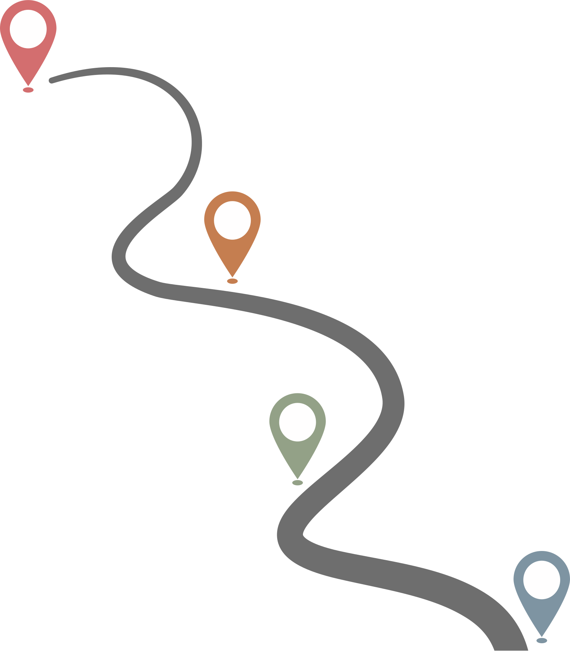
SLAM & NAVIGATION
COMPUTER VISION
SENSORS, ODOMETRY & SENSOR FUSION
MOBILE PLATFORM

Slide 3
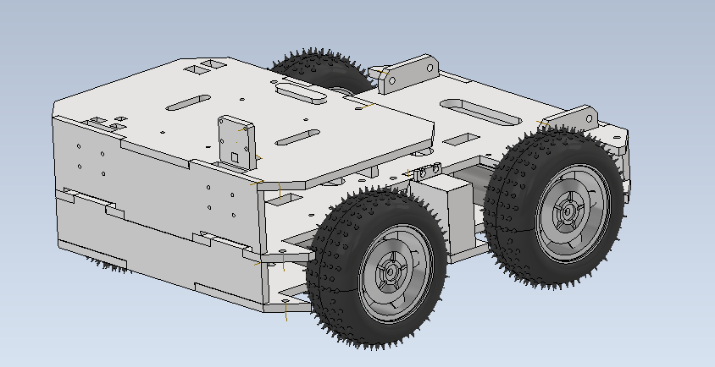
MOBILE PLATFORM: MECHANICAL
Drivetrain: 4-Wheel Differential Drive
Frame Material: PMMA
Aimed to minimize track, wheelbase, height

Slide 4
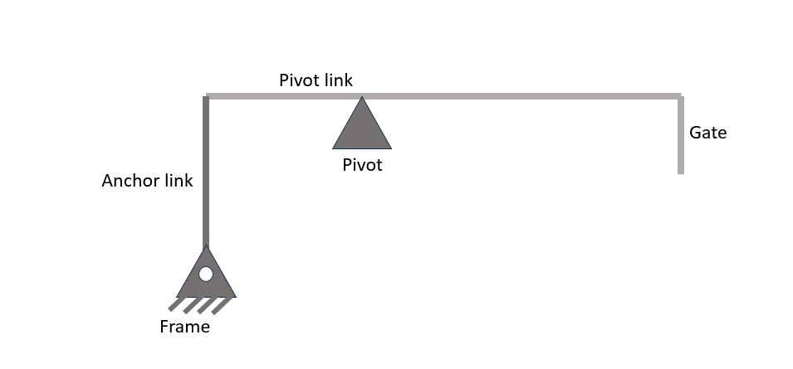
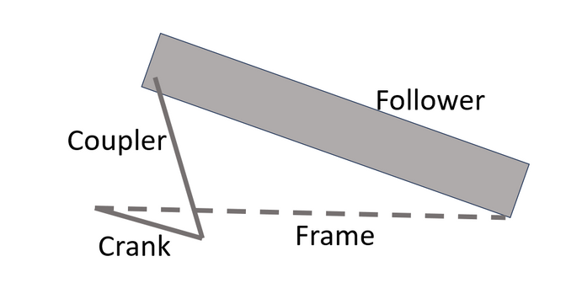

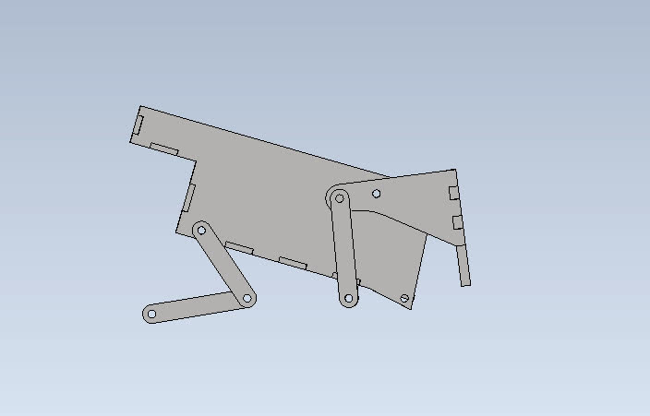
MOBILE PLATFORM: MECHANICAL
Offloading: Single-servo actuation

Slide 5
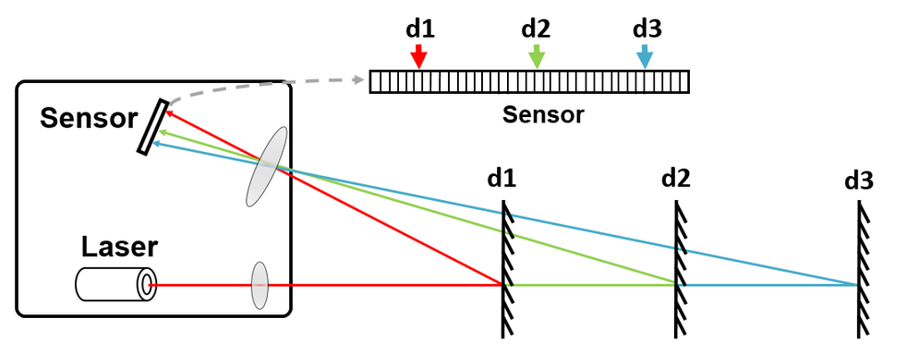
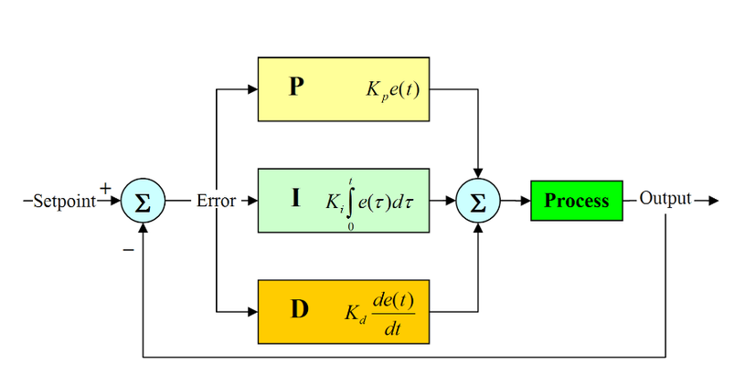
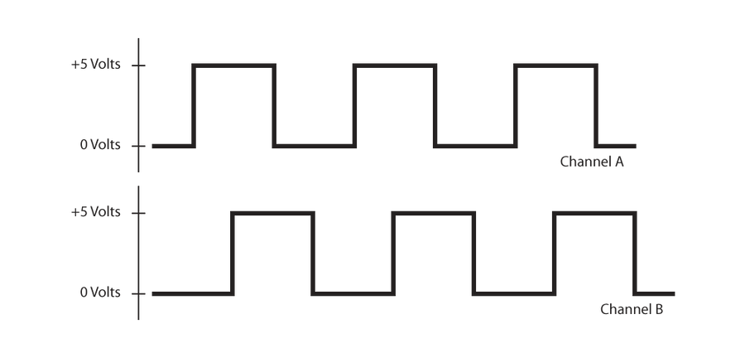
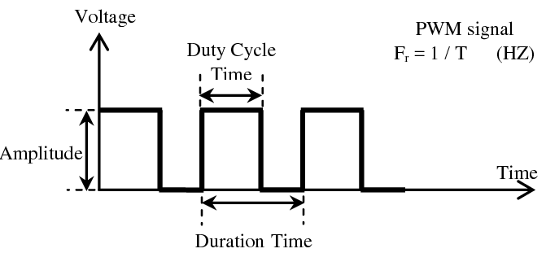
MOBILE PLATFORM: ELECTRONICS
Sensors: 4 rotary encoders, IMU, Lidar, Pi Camera
Actuators: 4 12V DC Motors, high-torque servo motor
Low-Level Controller: STM32F4 series MCU
High-Level Controller: Raspberry Pi 4
Power Supply: 11.1V Li-Po battery, USB Power bank
Featuring High Frequency PWM; PiD motor control

Slide 6
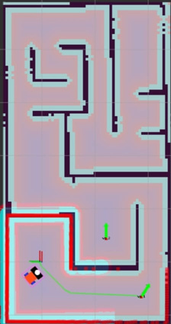
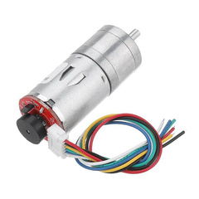
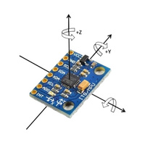
ACCURATE LOCALIZATION THROUGH SENSOR FUSION
Encoders – Track wheel rotations → estimate linear & angular displacement
IMU (MPU6050) – Measures acceleration & angular velocity → robot orientation
EKF Fusion – Uses non linear models like robot motion and orientation and linearizes them around the current estimate using jacobians
EKF[F,H]
ACCURATE POSE
Encoder data
IMU data
ekf fused path

Slide 7
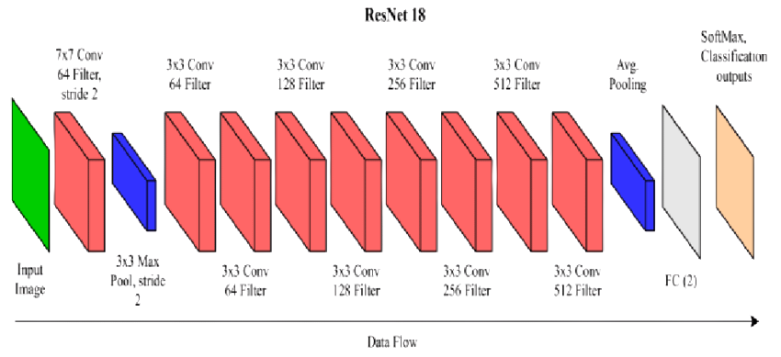

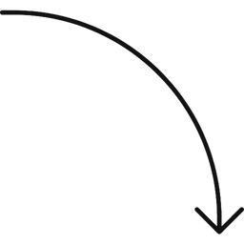
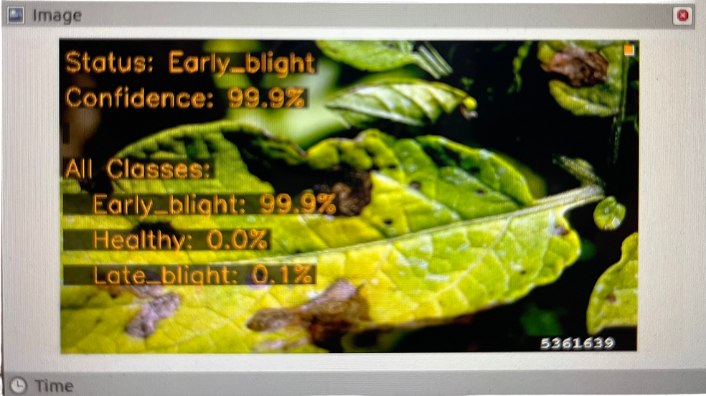
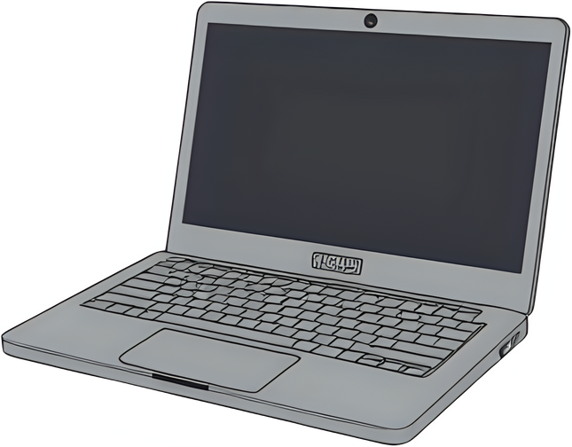

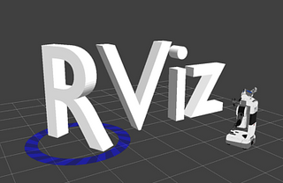
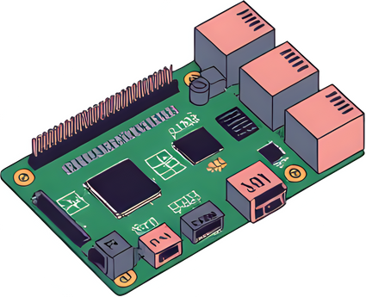
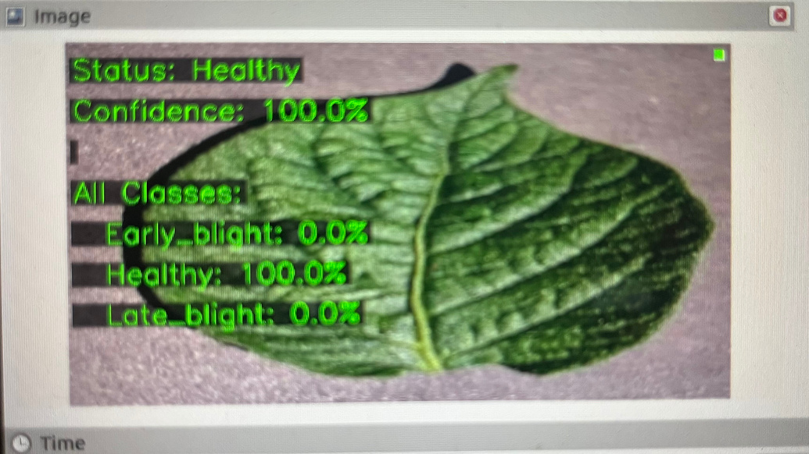
COMPUTER VISION
Image classification
Kaggle dataset
model
Image ⟶ /image
/inference_image

Slide 8
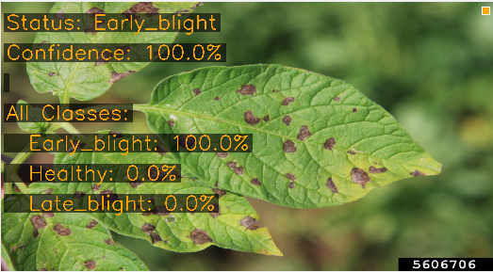
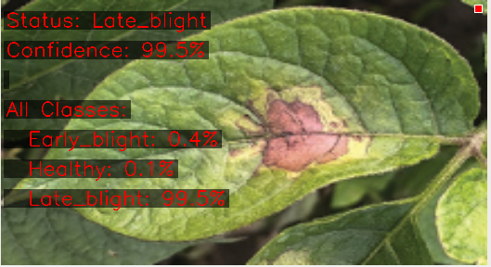
COMPUTER VISION
Image classification
Resnet 18 architecure used - 18 layers deep . Utilized transfer learning approach
Pretrained on 1.2 M ImageNet images - 1000 classes
Target - 3 classes ( healthy, early blight, late blight) ⟶ in potatoes
Early blight - Dark brown spot with concentric rings
Late blight - Gray-Green water soaked lesions
Prepared a new dataset with 21452 images
Why Resnet 18?
Pretrained.
Lightweight ⟶ 11 M parameters. Good for this task compared to Resnet 50+
Proven effective for plant disease detection ⟶ don’t reinvent the wheel
Relatively less computational resources
Optimization algorithm ⟶ Adam
Why Adam?
Good for small datasets
Faster convergence than SGD.

Slide 9
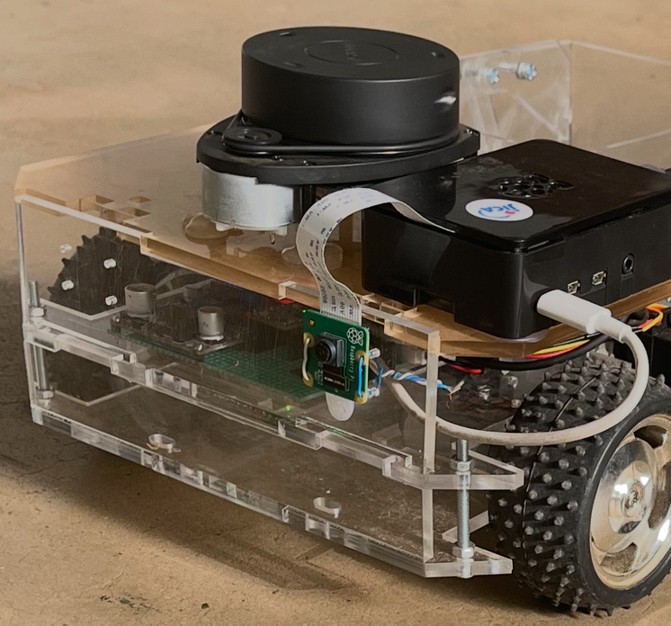
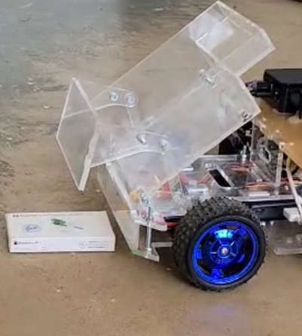
COMPUTER VISION
Object detection
Task ⟶ Deposit the loaded cube to the correct color coded offloading area.
Image ⟶ /
detected_color
/servo_controller
/commands
For color detection - OpenCv extensive libraries
HSV color space preferred over RGB
Time based rebounding - real world robustness
Modularity achieved - ROS2 nodes (2)

Slide 10
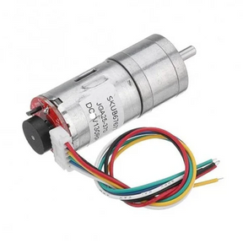
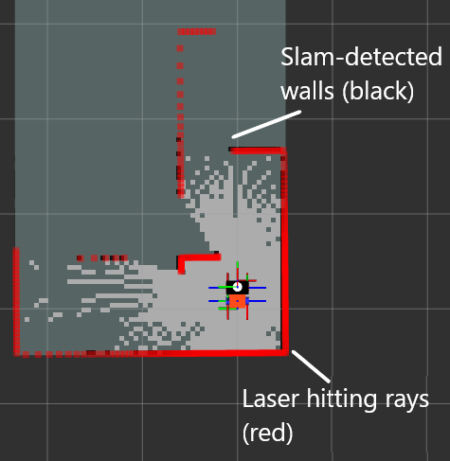
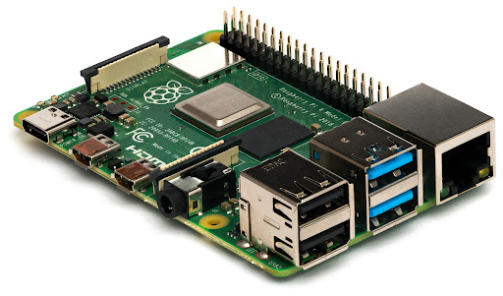
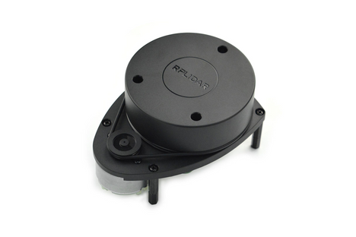
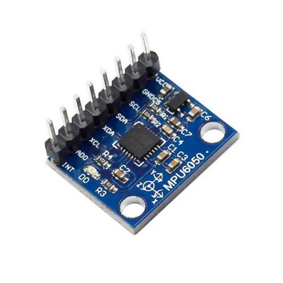
SLAM AND NAVIGATION
SLAM (Simultaneous Localization and Mapping) - Allows a robot to create a map of its environment while keeping track of its own location within the map.
It uses data from sensors such as encoders, LIDAR and IMU and odometry to build a consistent map without losing the robot’s POSE (Position and Orientation).
Encoder data
LIDAR data
Map + robot POSE
PI - SLAM, EKF processing
IMU data

Slide 11
Some of the packages used in SLAM include:
slam_toolbox: Responsible for publishing the coordinate transformations between the map frame and odom (odometry) frame which allows the robot to understand its POSE in the map.
amcl (Adaptive Monte Carlo Localization): Used mainly after mapping has taken place and facilitates autonomous navigation of the robot within the map by using LIDAR data for localization.
After mapping, Navigation takes place using a costmap. A costmap contains cells that quantify the the difficulty of the robot traversing each cell.
The costmap is made up of two types:
global_costmap: Covers the entire map and used for long distance path planning.
local_costmap: Covers the immediate surroundings of the robot and helps the robot avoid new obstacles not recorded on the saved map.

Slide 12
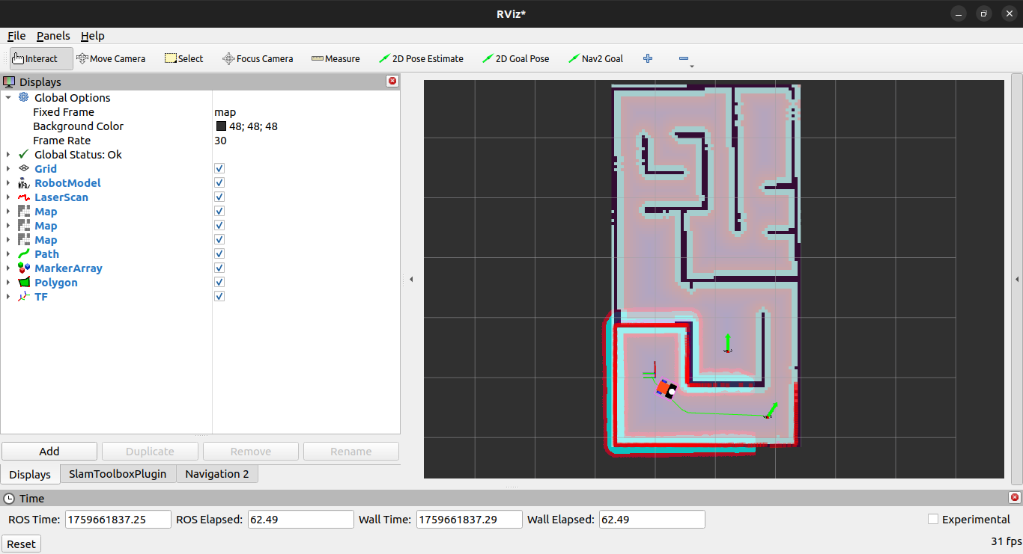
global_constmap
Inflation layer
Static layer
local_constmap

Slide 13
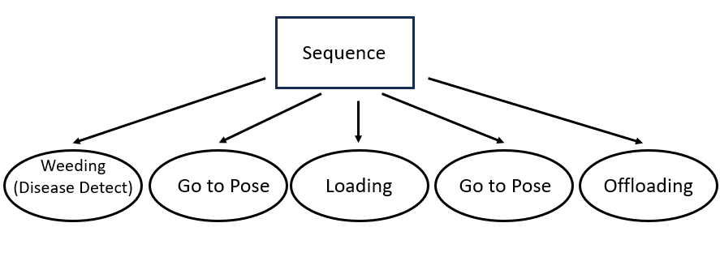
PYTREES

Slide 14
THANK YOU

